Slide 1
Data Structure

Slide 2
Array

Slide 3
Array
Value 1 | Value 2 | Value 3 | Value 4
The simplest composite type. Items can be looked up easily by calculating the memory address from the index.
Eg. myList is located at memory address 100, then myList[10] is at memory address 100 + 8 * 10 = 180.
Note: The values are usually pointers in modern languages.

Slide 4
Linked List

Slide 5
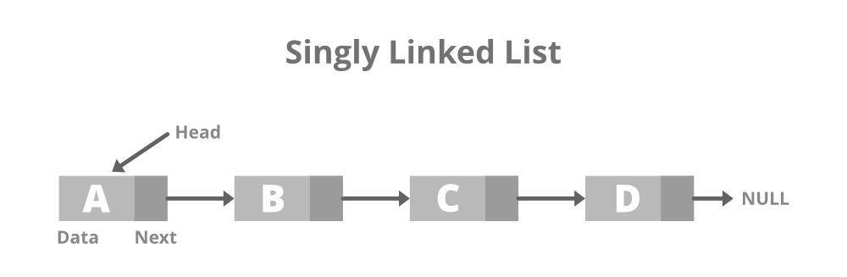
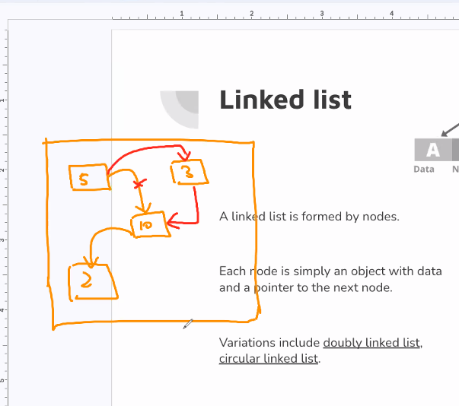
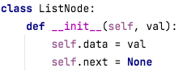
Linked list
A linked list is formed by nodes.
Each node is simply an object with data and a pointer to the next node.
Variations include doubly linked list, circular linked list.
Notes:
Python list is actually a linked list with a hashmap.

Slide 6
Linked list vs classic array
Operations | Linked list | Classic array
Insert/Remove items | Simply adjust the “next” pointer. | Need to move every item after the insertion/deletion index.
Access an item | Need to iterate from the head. | No iteration is needed.
Memory usage | More memory is used to store the objects and the “next” pointers. | Minimal memory usage.

Slide 7
Queue and Stack

Slide 8
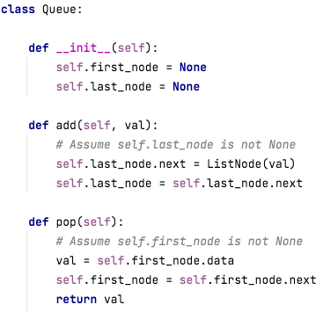
Queue
A list that supports “First in first out”.
Notes:
First In, First Out

Slide 9
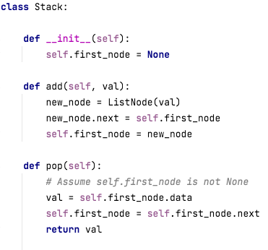
Stack
A list that supports “First in last out”.
Notes:
First In, Last Out

Slide 10
Hash table

Slide 11
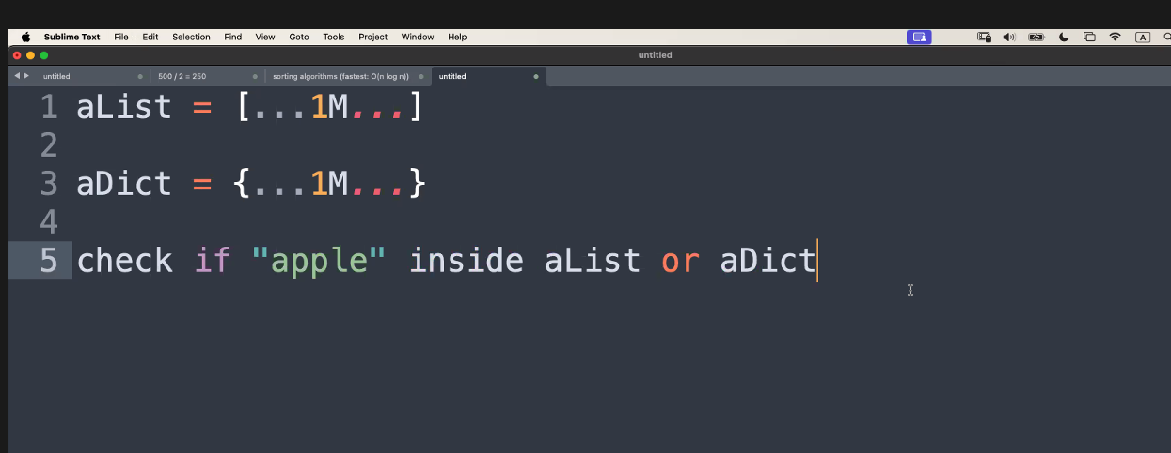
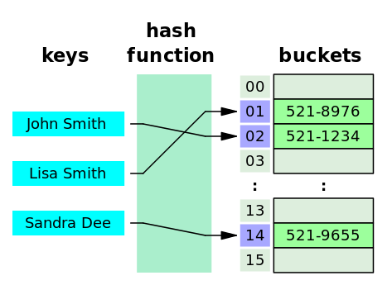
Hash table
Underlying a hash table, there is a list to store values.
Imagine it is a list of “Buckets”.
Hash function create a number for a given key. Such number is the index of the value location.
Notes:
Which one is faster? List or dictionary?

Slide 12
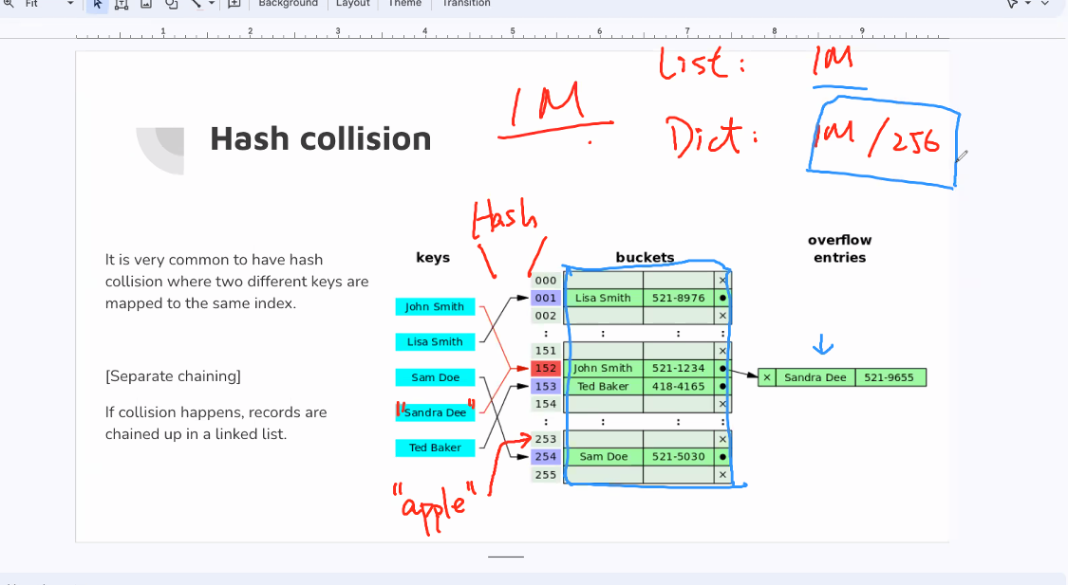
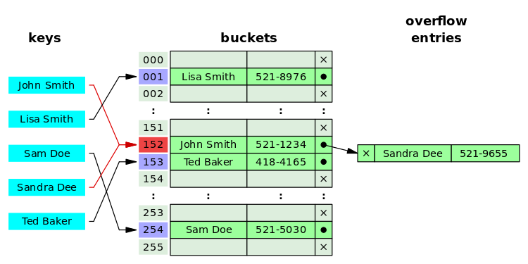
Hash collision
It is very common to have hash collision where two different keys are mapped to the same index.
[Separate chaining]
If collision happens, records are chained up in a linked list.

Slide 13
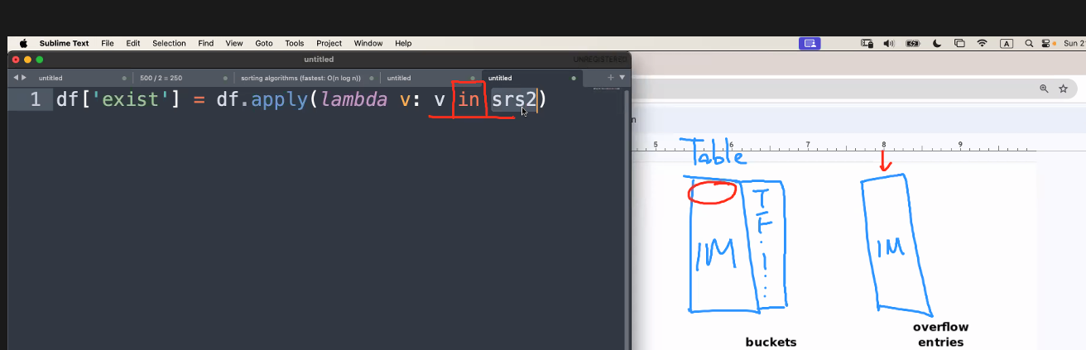
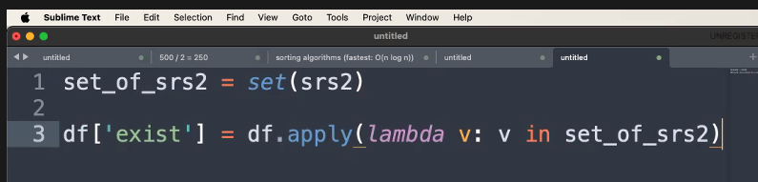
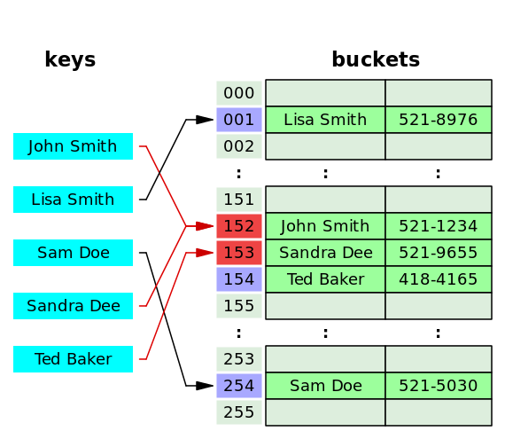
Hash collision
Time needed: 1 mil x 1 mil
Just change one thing:
[Open addressing]
If collision happens, the algorithm search down the list for an empty slot
Hash table is useful for speeding up lookup
Make it in a dictionary / set (hash table)
Instead of sequential search
(searching in a list)
A set is a dictionary (hash table) without a value
Dictionary is the key-value pair
If there ignore the value, it is a set

Slide 14
Python dictionary implementation
https://github.com/python/cpython/blob/main/Objects/dictobject.c

Slide 15
Tree

Slide 16
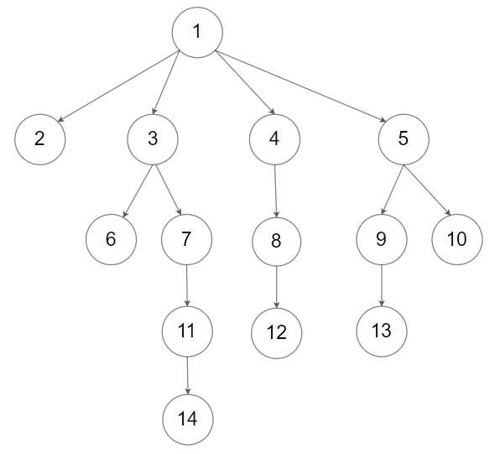
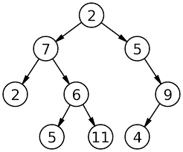
Trees
Binary Tree
N-ary Tree

